Slide 1
Characterization and Conversion of
Animal Fat to PCM
for Thermal Storage Applications
Christine Zou, Chenhui Yang, Justin Kim, Mehdi Zadshir, Xiaokong Yu
Advisor: Prof. Huiming Yin
Summer 2020

Slide 2
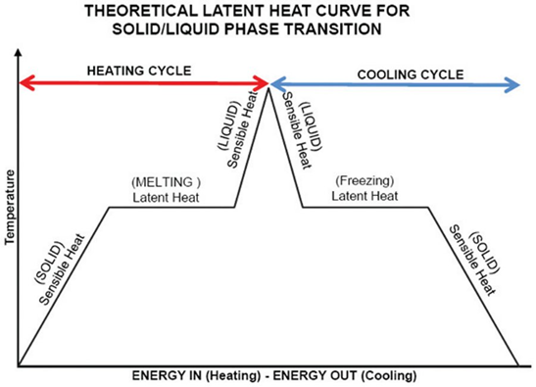
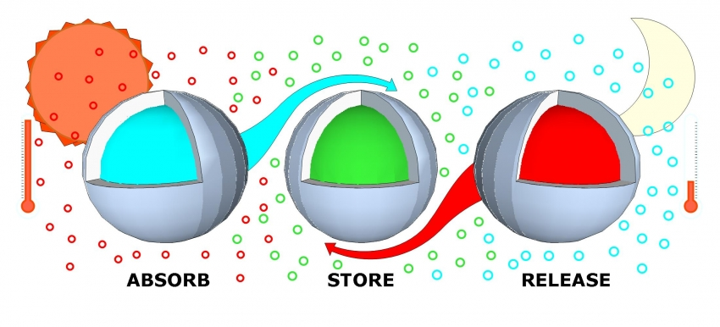
Phase Change Materials (PCMs)
In phase change materials, latent heat (phase transition) is used for thermal energy storage
When a material melts, it absorbs energy and then when it freezes, the energy gets released
Most common PCM is water/ice but since the freezing temperature is 0℃, making it unsuitable for most applications
https://www.pharmoutsourcing.com/
https://www.aiaaustin.org/event/phase-change-materials-pcm-high-performance-enclosures

Slide 3
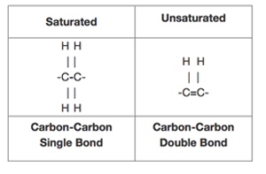
Saturated vs. Unsaturated Fatty Acids
Unsaturated fatty acids have one or more double bond in their carbon chain
In terms of thermal properties:
Saturated fatty acids have higher latent heat
Saturated fatty acids have higher melting temperature (typically solid at room temperature, unsaturated fatty acids are typically liquid at room temperature)
https://www.scienceofcooking.com/difference-between-saturated-and-unsaturated-fats.html

Slide 4
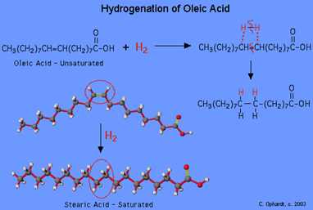
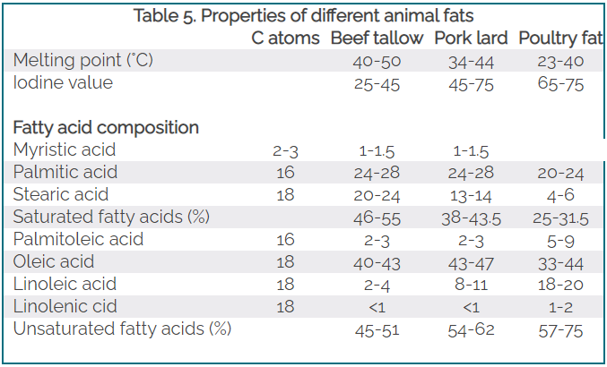
Animal Fat
Animal fat typically has at least 50% composition of unsaturated fatty acids (mainly oleic acid)
Since we want the saturated fatty acids, we have to separate saturated and unsaturated
To obtain more saturated fatty acids, we can also hydrogenate the unsaturated fatty acids
http://chemistry.elmhurst.edu/vchembook/558hydrogenation.html
https://lipidlibrary.aocs.org/edible-oil-processing/animal-fats

Slide 5
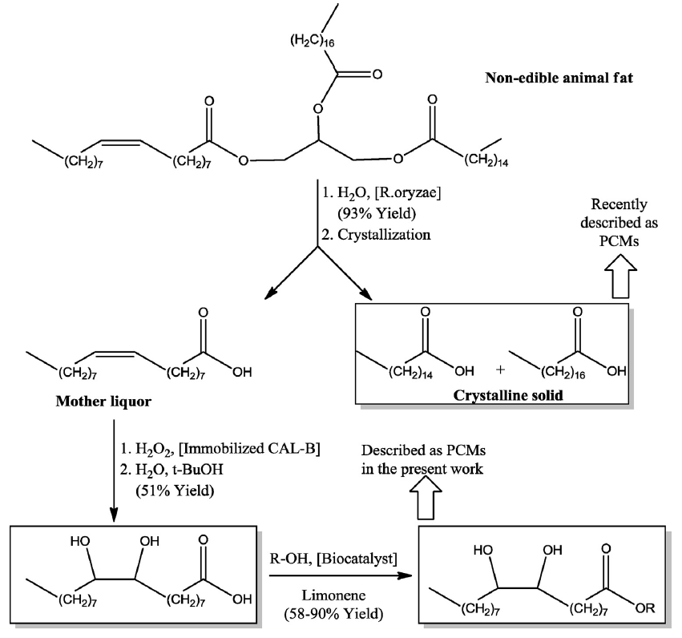
Literature Review
Fabiani et al., Kahwaji, S. and M. A. White, and Boussaba et al. experimented with transforming bio-based material (animal fat or vegetable oil) to a PCM
Gallart-Sirvent et al. successfully converted saturated animal fat and unsaturated animal fat into PCMs (but separately)
All these methods either just used saturated
(or saturated/unsaturated separately) or did not separate the two.
Saturated
Unsaturated
Gallart-Sirvent, P., et al. (2018). "Combining biocatalysts to achieve new phase change materials. Application to non-edible animal fat." Molecular Catalysis 444: 76-83.

Slide 6
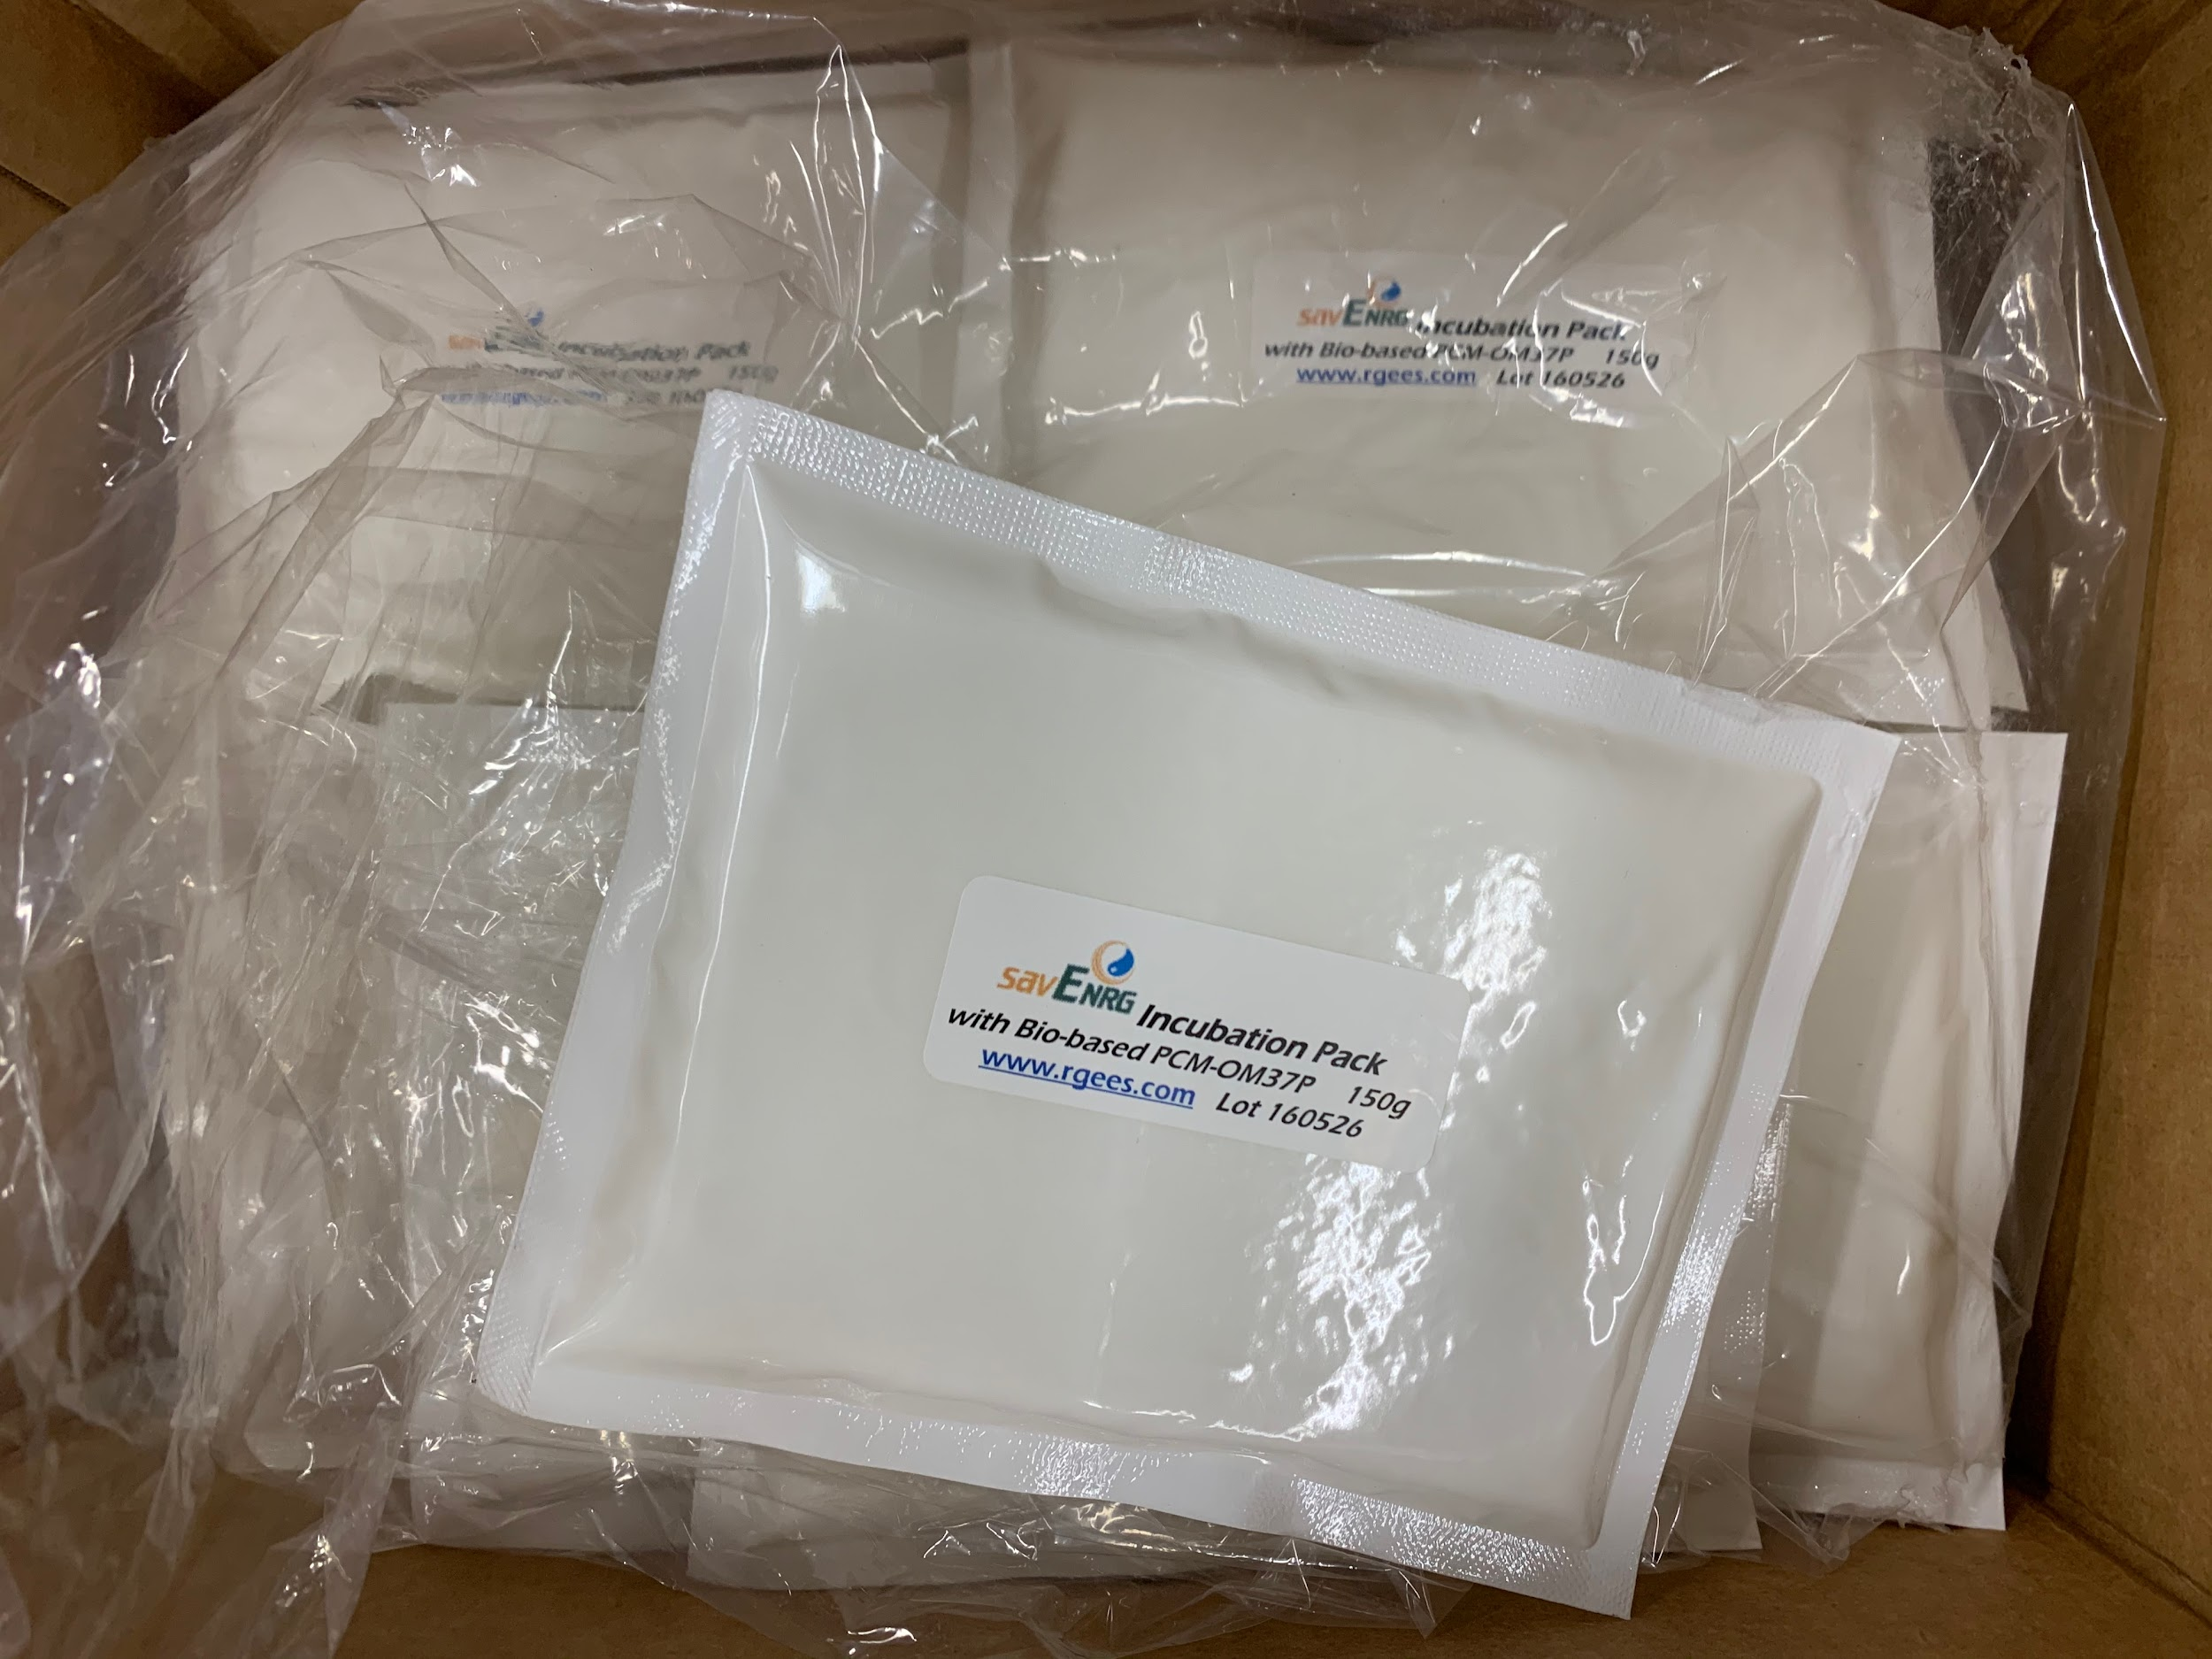
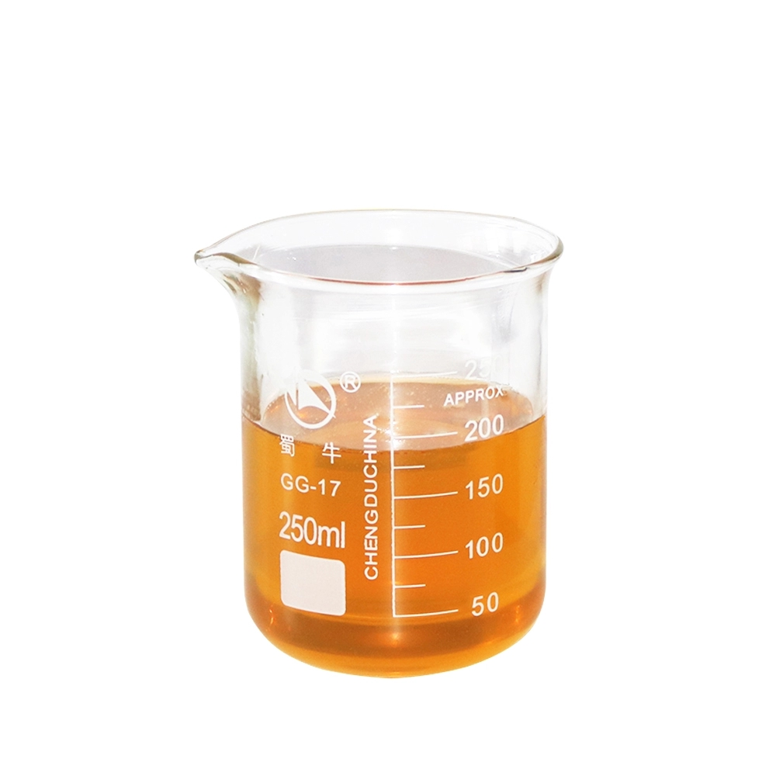
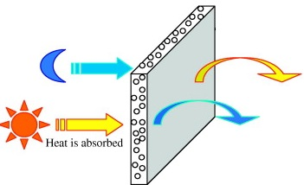
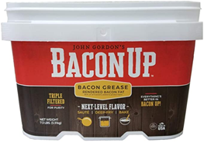
Animal Fat based PCMs
Problem Statement:
Commercial PCMs are costly and most of animal fat goes to waste in the food industry
Objective:
Transform animal fat (bacon grease in this research) to
an effective phase change material (PCM) for thermal
energy storage applications
Commercial PCM: $30/Kg
Ling, T. C., & Poon, C. S. (2013). An overview. Construction and Building Materials, 46, 55-62.

Slide 7
Methodology
Characterize: detect molecules of bacon grease
Hydrolysis: obtain free fatty acids from triglycerides in the fat
Separation: separate saturated and unsaturated fats
Hydrogenation: convert unsaturated fats to saturated fats
Esterification: convert fatty acids to fatty acid esters
In this project, all these processes are applied in whole to an animal fat to convert it into a PCM.

Slide 8
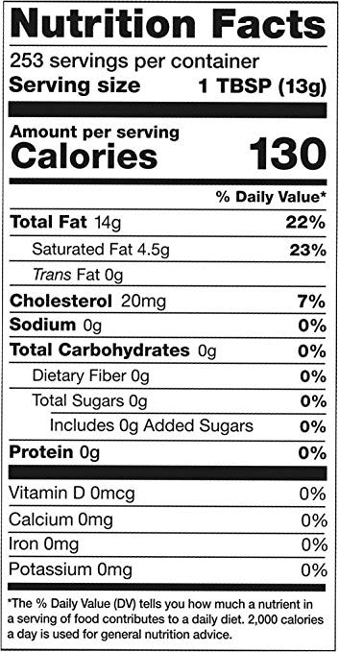
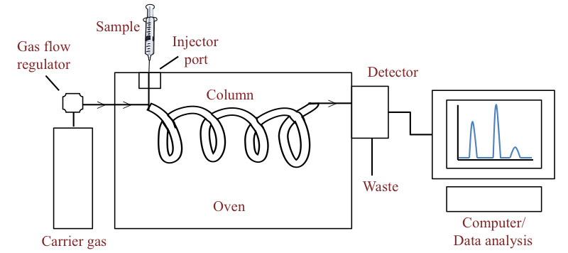
Characterization
Use of gas chromatography to identify what fatty acids are present in the animal fat
Percent composition of saturated vs. unsaturated fatty acids
As well as more specifically the percent compositions of palmitic, stearic, and oleic fatty acids
https://microbenotes.com/gas-chromatography/
https://baconup.com/product/bacon-up/

Slide 9
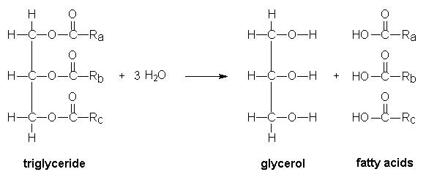
2) Hydrolysis
Process of using water to break apart a molecule
Animal fats are mainly composed of molecules of triglycerides but the fatty acid portion is what we need for PCMs.
Here, we are using hydrolysis to break the triglycerides to get free fatty acids
There are several methods of triglyceride hydrolysis:
saponification, enzymatic hydrolysis, high-pressure steam splitting, double metal cyanide catalyst, etc.
1 triglyceride → 1 glycerol + 3 fatty acids
Ignatius, I. and A. Sagar (2017). Cavitation Report.

Slide 10
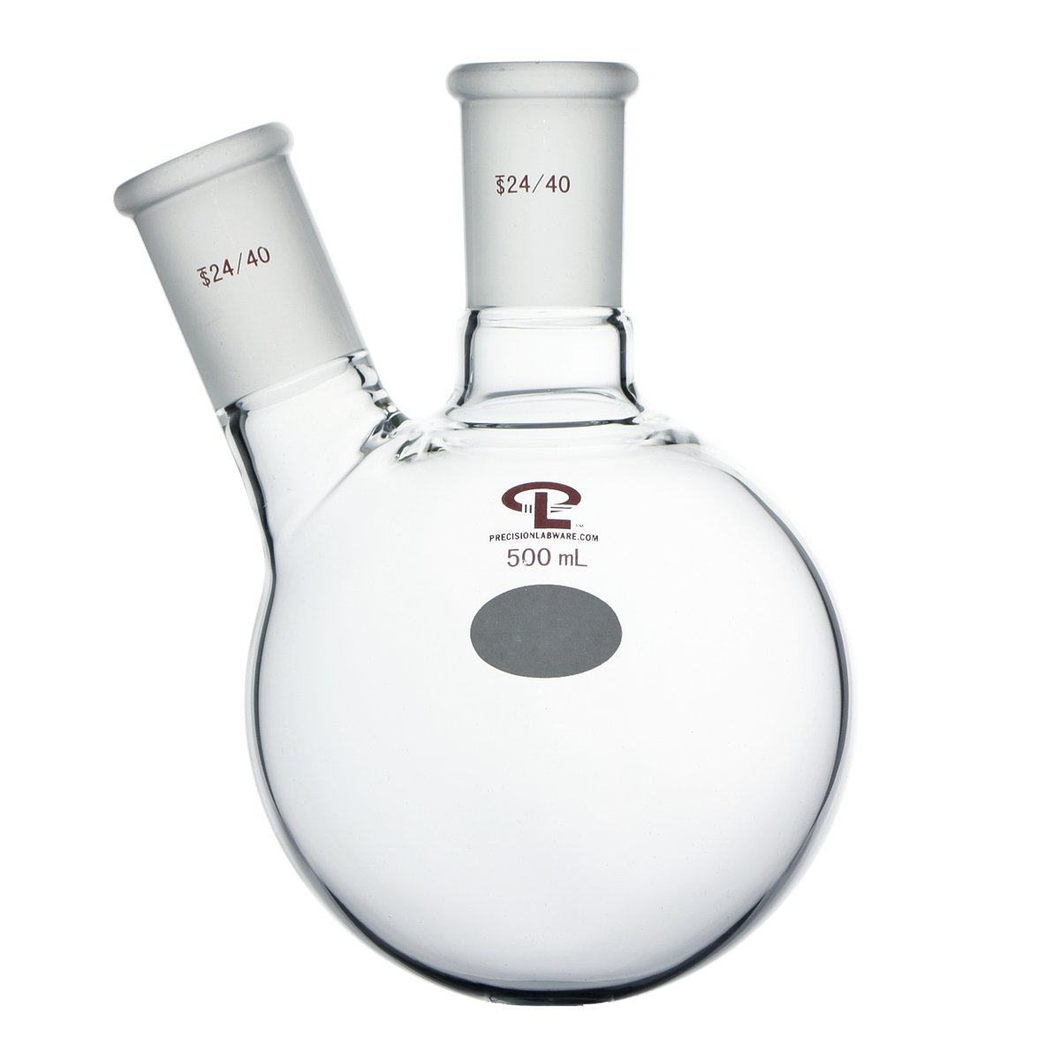
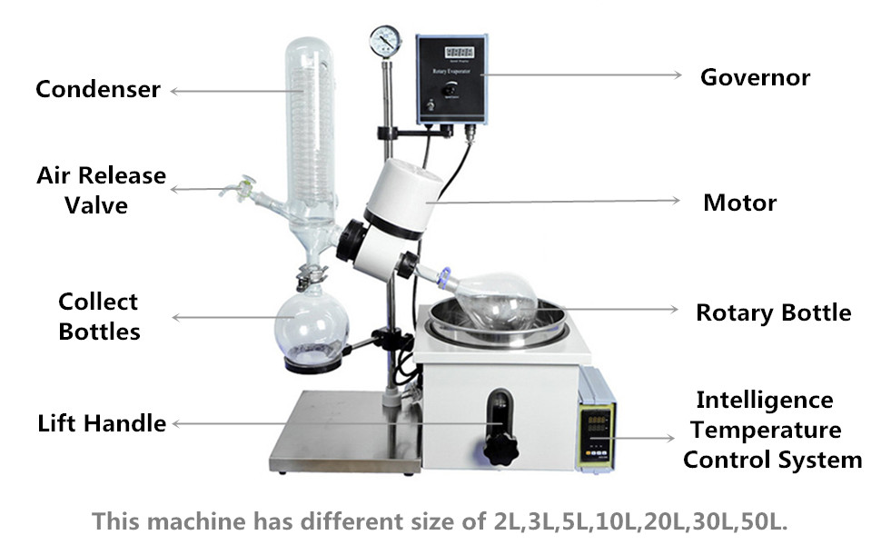
Hydrolysis Method
Prepare hydrolysis solution: ethanolic potassium hydroxide and ethanol
Add animal fat and hydrolysis solution in a two-neck round-bottom flask at 70℃ for 2h
Add water with hexane to the flask to separate fatty acids and glycerol phases
Acidify with HCl to pH=1 and then recover FFAs (free fatty acids) with extraction using a nonpolar solvent such as hexane
Wash the extracted fatty acids with distilled water to a neutral pH
Use a separating funnel to remove the lower glycerol layer
Dry the upper layer FFAs with a drying agent such as anhydrous sodium sulphate
Evaporate hexane with vacuum rotavap
Japir, A. A.-W., et al. (2018). Oilseeds & fats Crops and Lipids Journal Volume 25.

Slide 11
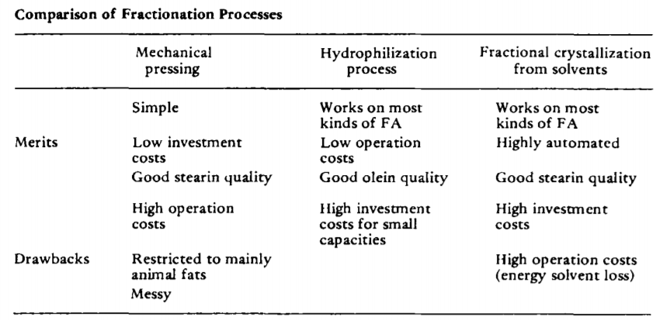
3) Separation
Separating the saturated and unsaturated fatty acids in the fatty acid mixture obtained after hydrolysis
Different separation methods:
mechanical pressing, hydrophilization, dry fractionation, and crystallization
Haraldsson, G. J. J. o. t. A. O. C. S. (1984). "Separation of saturated/unsaturated fatty acids." 61(2): 219-222.

Slide 12
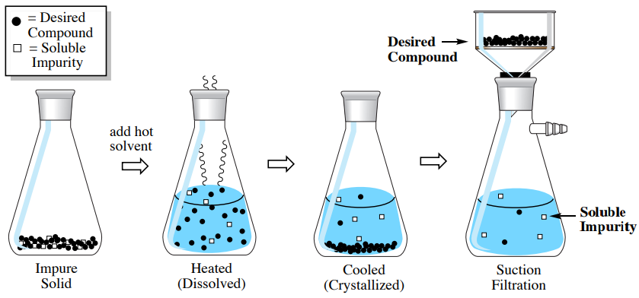
Separation by Crystallization
Separation by crystallization relies on different solidification temperatures as well as the solubility in the solvent to separate the desired compound out of a mixture.
Things that must be considered:
Solubility of the desired compound vs. impurities
Solute to solvent ratio
Temperature of crystallization
Length of time for crystallization
https://chem.libretexts.org/Bookshelves/Organic_Chemistry/Book%3A_Organic_Chemistry_Lab_Techniques_(Nichols)/03%3A_Crystallization/3.03%3A_Crystallization_Theory/3.3.0E%3A_3.3E%3A_Quantitating_Crystallization

Slide 13
Crystallization Method
Dissolve FFAs (free fatty acids) in methanol with strong stirring, increasing temperature if needed.
Experiment with the fatty acid: solvent ratio to find the ideal ratio
Cool mixture progressively to crystallization temperature and time
Experiment with time and temperature
Filter using a Buchner funnel with reduced pressure (funnel cooled to crystallization temperature)
Wash crystals (saturated fat) with methanol (pre-cooled to crystallization temperature)
Evaporate solvent under reduced pressure using a rotavap
Repeat with solid fraction for double crystallization
Japir, A. A.-W., et al. (2018). Oilseeds & fats Crops and Lipids Journal Volume 25.

Slide 14
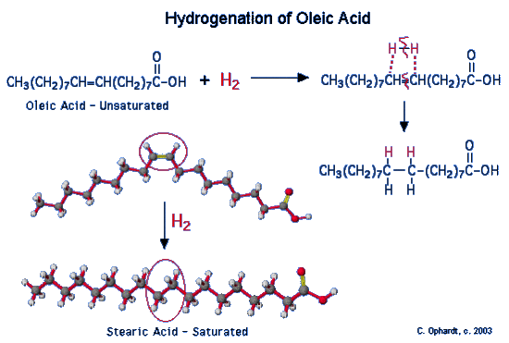
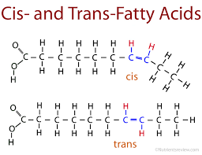
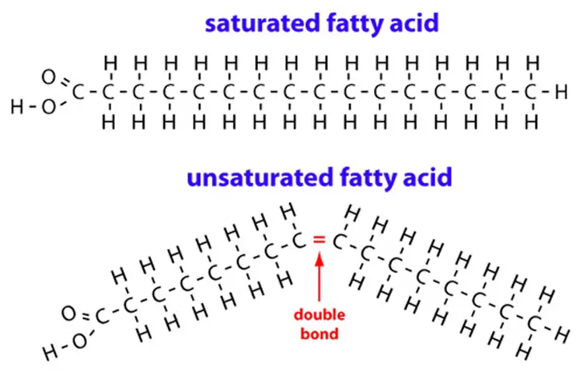
4) Hydrogenation
Simple process to transform unsaturated fatty acids to saturated ones
After seperation, we have oleic acid (unsaturated) and palmitic and stearic acids (saturated).
Here, the oleic acid will be hydrogenated into stearic acid
Reaction rate and efficiency are affected by catalyst.
Hydrogenation produces trans fatty acids as well.

Slide 15
Hydrogenation Process
Add hexane to dissolve the processed unsaturated fatty acid and prevent solid dissipation during hydrogenation process
Add catalyst (Pd/C powder 10%wt 1g per 100ml sample) into the solution and put a stir bar inside the solution
Stir the solution and cap the reaction container with a gas control valve connected to both H₂ and to the hood/waste gas deposit balloon.
Fill the reaction container with H₂ and then pump it down. Repeat this step more than 3 times. The excess H₂ should be released to the the hood or stored safely.
Keep stirring the solution at room temperature for more than 2 hours until the solution is hydrognized. (Sample turns into solids)
Disconnect the sample from aspiration system and heat the sample to 150 C to evaporate hexane. Filter the catalyst from heated solution. (H₂ filled Pd/C is flammable and thus should not be dried. Store it inside Ar or dispose into celite)
Reference video link:https://www.youtube.com/watch?v=oqdDWA9-DSY

Slide 16
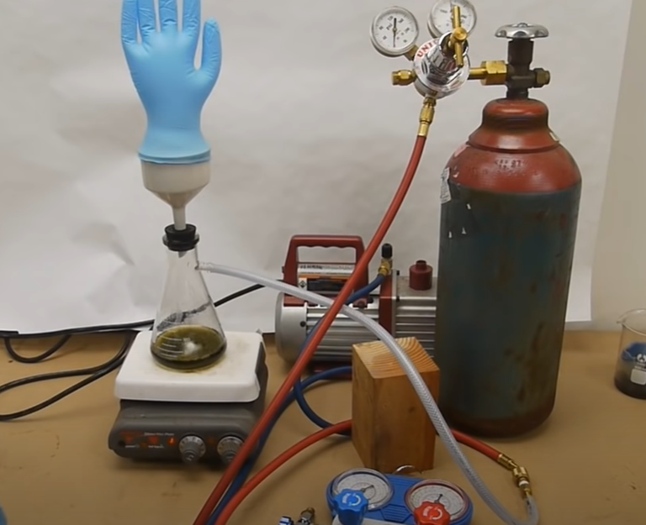
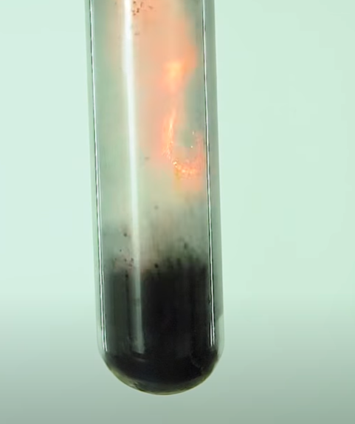
Hydrogenation Process
Reference video link:https://www.youtube.com/watch?v=oqdDWA9-DSY
https://www.youtube.com/watch?v=_oM9dRzISNQ

Slide 17
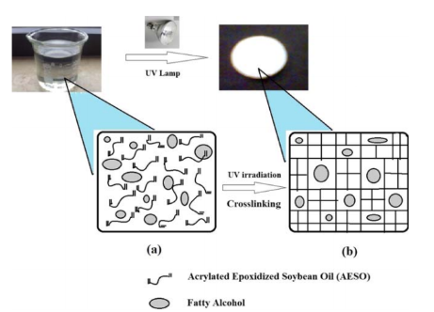
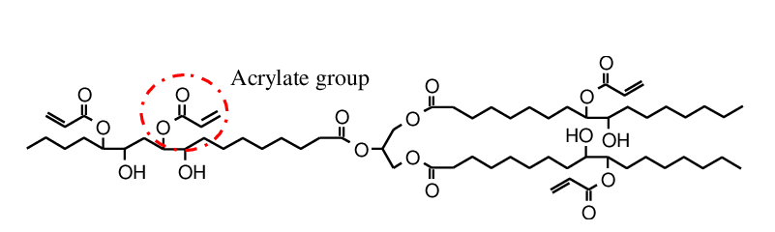
Hydrogenation: potential UV enhancement
Some fatty acid molecules has multiple unsaturated position (carbon double bond) on the carbon chain
Ultraviolet curing can crosslink carbons in the double bond to create a polymer matrix
During this process the number of carbon double bond is decreased
Acrylated Epoxidized Soybean Oil
Baştürk, E., & Kahraman, M. V. (2016). Photocrosslinked biobased phase change material for thermal energy storage. Journal of Applied Polymer Science, 133(32).

Slide 18
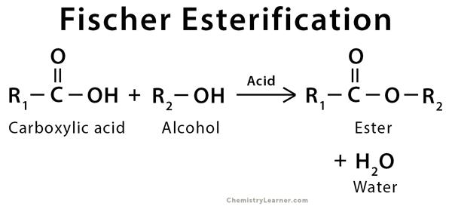
5) Fischer Esterification
Esterification is the reaction between an acid and an alcohol that produces an ester; the reaction is catalyzed by a strong acid
In our work, stearic and palmitic acids (saturated) from the hydrogenation process and with use of ethylene glycol (alcohol) will react to perform esterification.

Slide 19
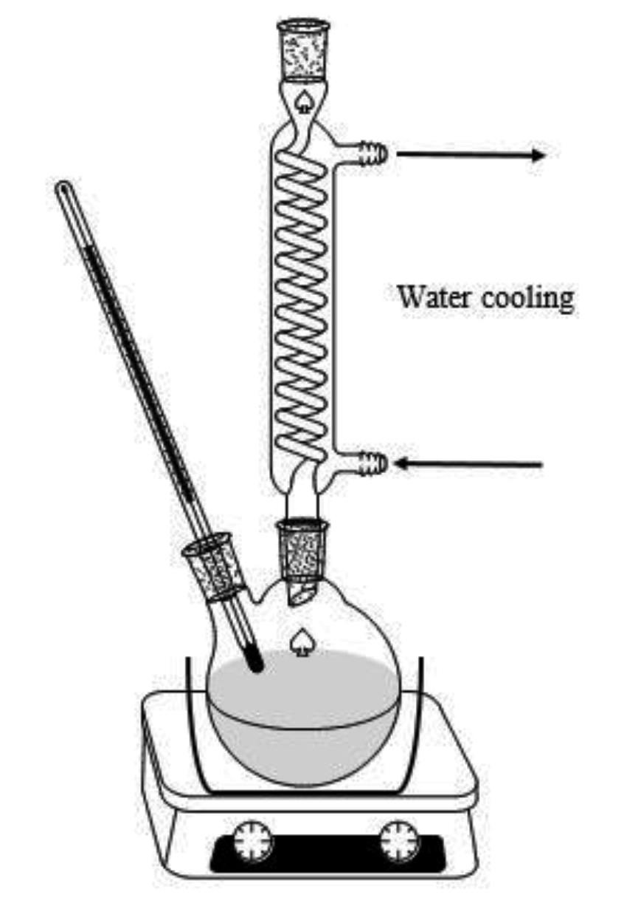
Esterification Procedure
Mix a 1:10 molar ratio of stearic acid to ethylene glycol
4:1 Molar ratio of acid to catalyst (Sulfuric Acid)
Heat and stir the mixture at 197°C for 3 hours
Use a reflux condenser to keep the ethylene glycol from evaporating
Allow the mixture to cool down below boiling and settle to a biphasic layer
Boil the excess ethylene glycol in a short path condenser
Ethylene glycol has a much lower boiling point than glycol distearate
Kastratović, V., & Bigović, M. (2018). Chemical Industry and Chemical Engineering Quarterly.

Slide 20
Eutectics vs Esters
Eutectics are mixtures of two or more components in phase change materials
Esters
wide phase change temperature range
high latent heat capacities
odorless
non-corrosive
Eutectic Mixtures
low costs
high latent heat capacities
lower phase change temperature
not much flexibility in phase change temperature
VS.
In our research, we can either mix the saturated fatty acids to obtain a eutectic mixture or esterify all of the saturated fatty acids.

Slide 21
Conclusions
In this work, processes required for transforming animal fat into PCM were studied.
The five processes are:
1) Characterization, 2) Hydrolysis, 3) Separation, 4) Hydrogenation, and 5) Esterification.
After characterization of the fat and detecting the composition, hydrolysis is used to break the animal fat molecules and obtain free fatty acids.
Separation by crystallization is done to separate the saturated fatty acid from the unsaturated ones.
Hydrogenation process is performed to convert the unsaturated fatty acids to saturated.
Esterification of saturated fatty acids results in having a high latent heat capacity, wide phase change temperature range while also being odorless and non corrosive.

Slide 22
Acknowledgment
Special appreciations to Professor Huiming Yin.
Dr. Xiaokong Yu for her time and input to the project.
NSF IUCRC Center for Energy Harvesting Materials and Systems for the research opportunity.

Slide 23


Thank You!
Link to Material List and Procedure Steps

